Slide 1
Alone
Survival Analysis
02/06/24
Bryan A. Ortega León

Slide 2
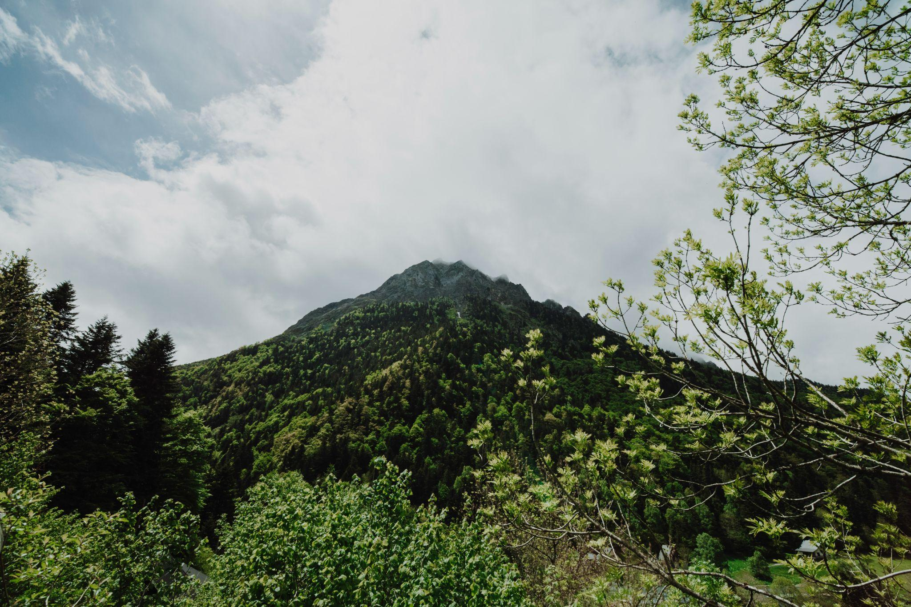
Table of contents
01
04
02
05
03
06
Introduction
EDA
Dataset
Metrics
Methods
Conclusion

Slide 3
Introduction

Slide 4
Introduction
Alone
Analysis
"Alone" is reality TV series that tests the limits of human survival. In this competition, individuals are dropped into remote wilderness locations, completely isolated from other contestants and the outside world. The challenge is to remain the longest in the wilderness and survive in the most unforgiving environments on Earth.
With our dataset we aim our analysis to find any insights on how long the contestants lasted, their demographics and backgrounds.

Slide 5
Dataset
survivalists.csv (df_survivalists) | Details like contestants name, age, gender, profession, amount of days lasted, season they participated in and reason they quit.
loadouts.csv (df_loadouts) | A list of the 10 items each contestant is allowed to bring for their survival.
seasons.csv (df_seasons): | A list of each season, location, country, latitude, longitude and amount of contestants per season.
episodes.csv (df_episodes) | A list of each episode, the season, episode number, air date, title, a quote and its author and the ratings.

Slide 6
Clean & Transform of Dataframes
(df_survivalists_clean) | Details like contestants name, age, gender, profession, amount of days lasted, season they participated in and reason they quit.
(df_loadouts_clean) | A list of the 10 items each contestant is allowed to bring for their survival.
(df_armed) | Merged the cleaned survivalist dataframe with the clean loadout dataframe on name and season to make our initial analysis.
(profession_category_stats) | Mapped all of the unique professions into professional categories to find the average amount of days laster per professional category.
(analysis_df_clean) | Utilised one hot encoding to transform each item in a row into its own column to make a statistical analysis for each item the contestants took using (mean, median, standard deviation and correlation)

Slide 7
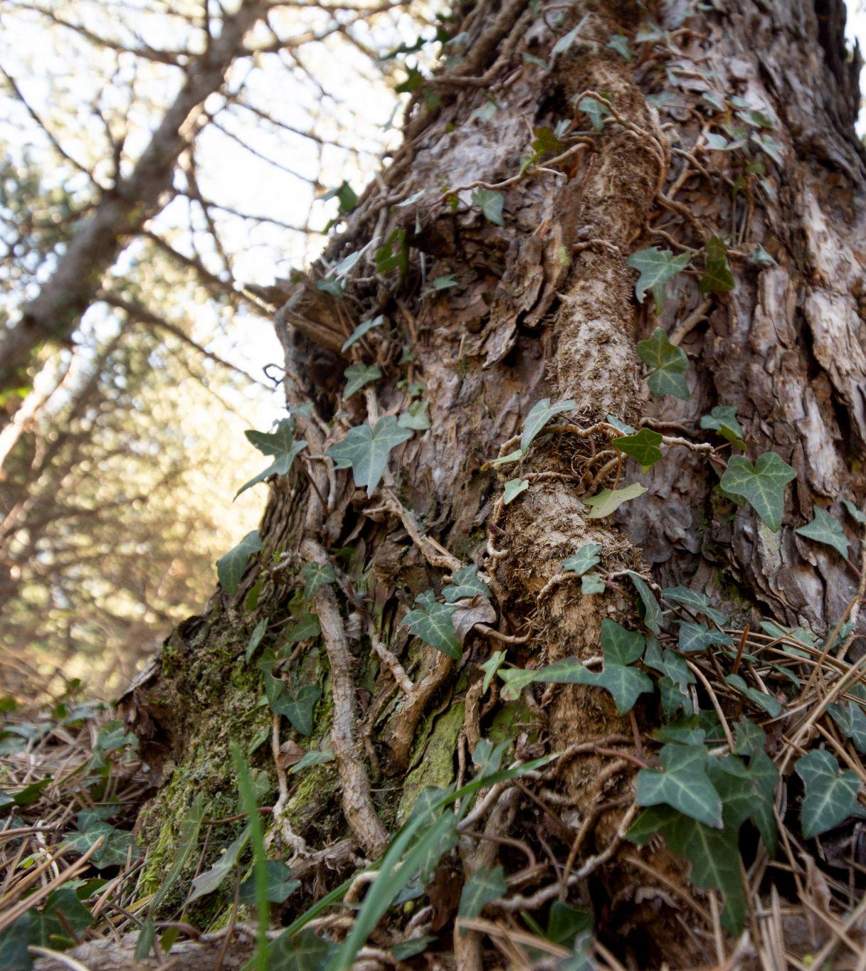
Methods
General
Head
Columns
Count
Cleaning
Drop na values
Fill na
Nunique
Transformation
Merge
Groupby
Sort values

Slide 8
E.D.A
Aggregation
(Mean, Median, Standard Deviation)
Correlation
Mapping

Slide 9
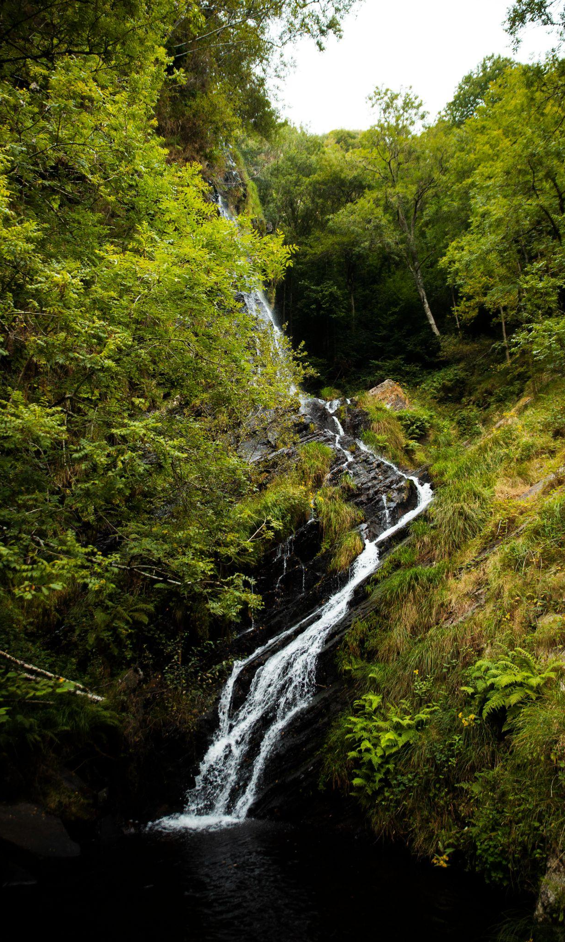
Questions & Data
Gender and Survival Time
Do men and women last different amounts of time on "Alone"?
Professional Background and Survival
Do people with outdoor jobs or survival training last longer on "Alone"?
Age and Survival
Does age matter to be able to survive longer on the show?
Tools for Survival
Is any given tool or item going to decide how long you last in "Alone"?

Slide 10
KPIs
39.04255319148936
39.5
27.85
Avg. Duration of Contestants
Median Duration
Standard Deviation of Survival Duration

Slide 11
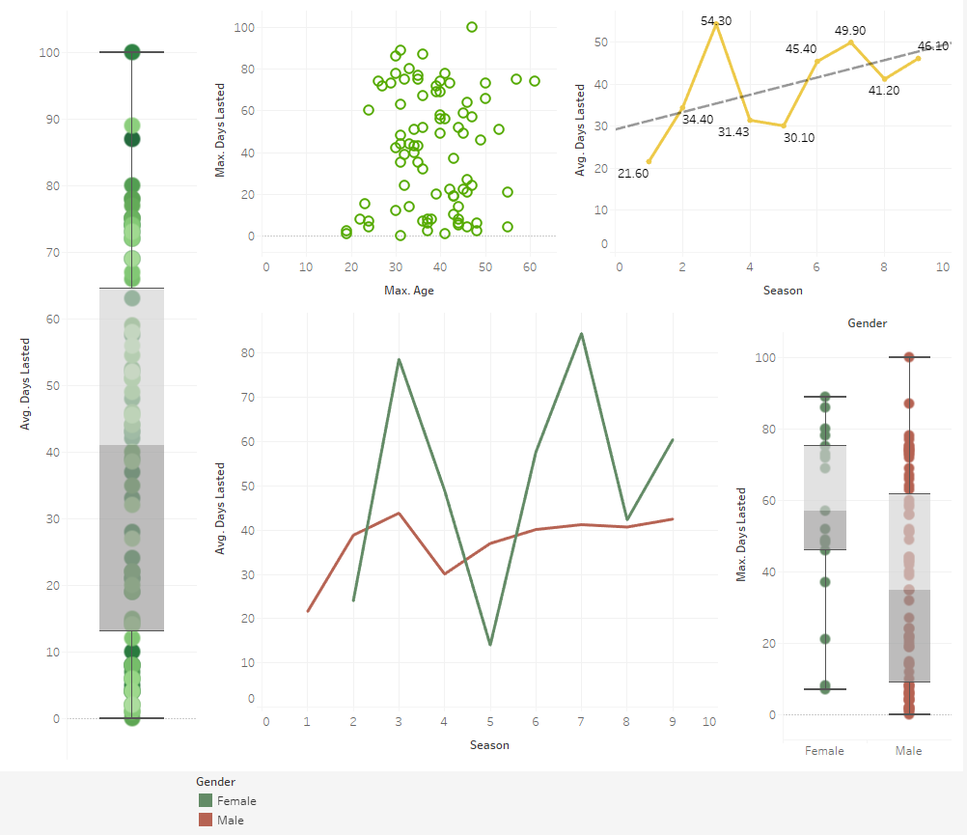
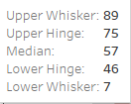
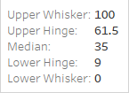
Gender and Survival Time

Slide 12

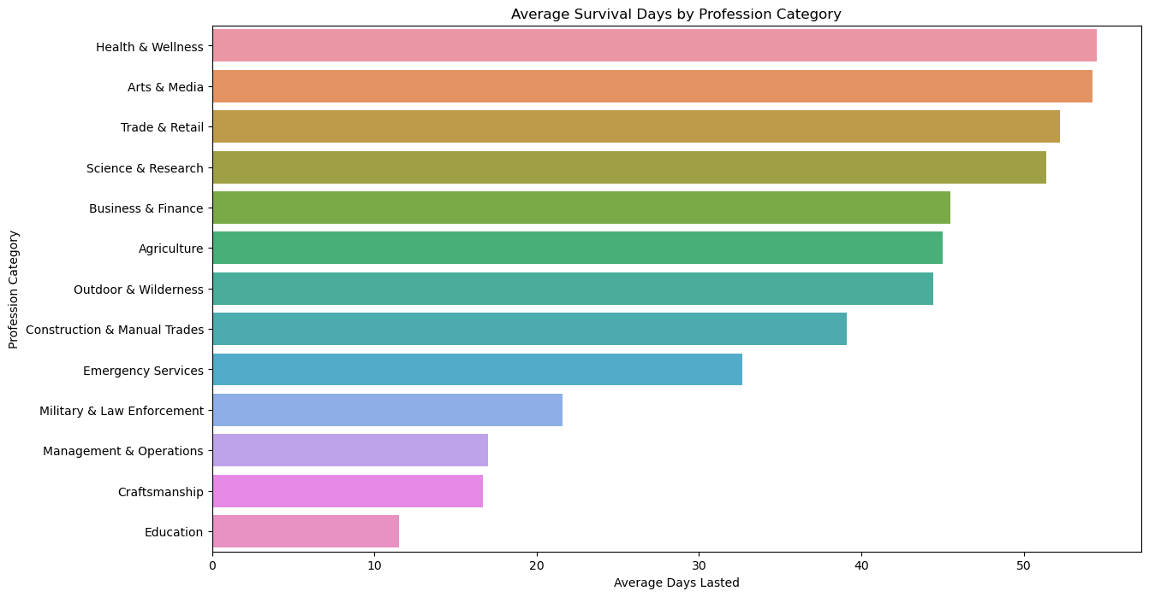
Professional Background

Slide 13
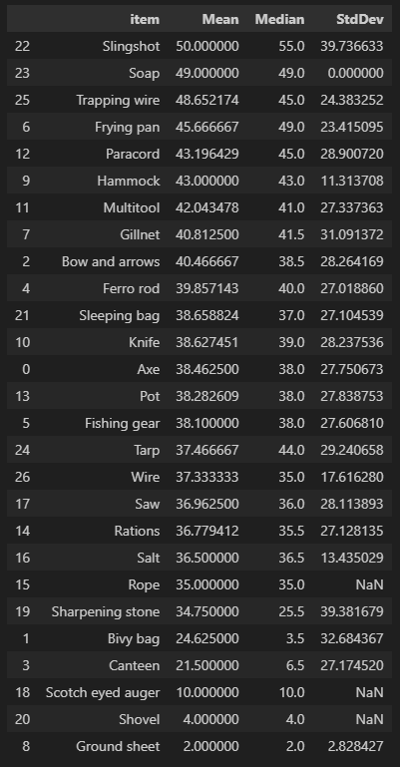
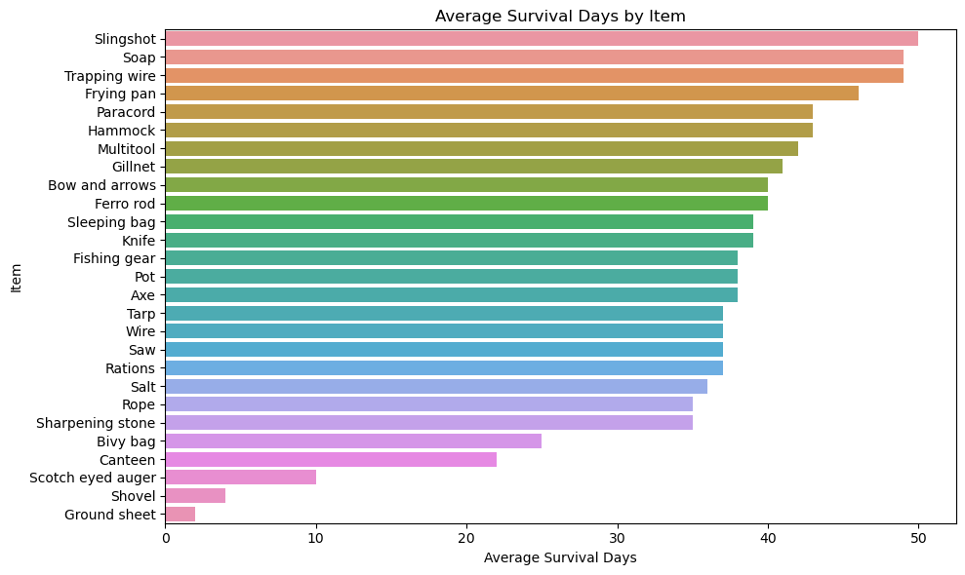
Age and Survival
Items & Tools

Slide 14
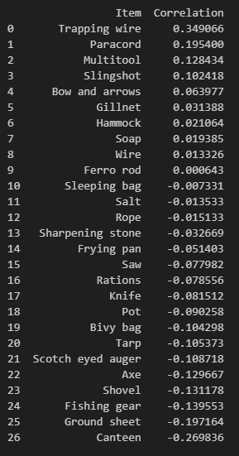
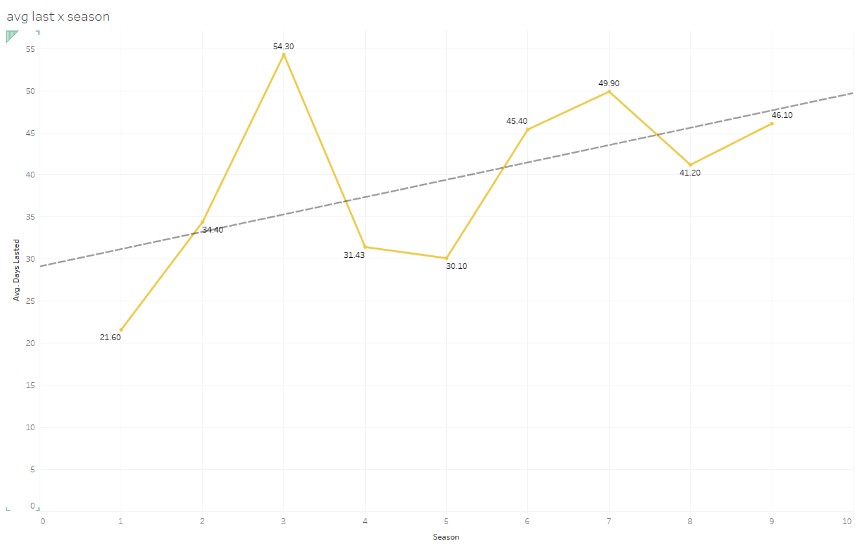
More Data…

Slide 15
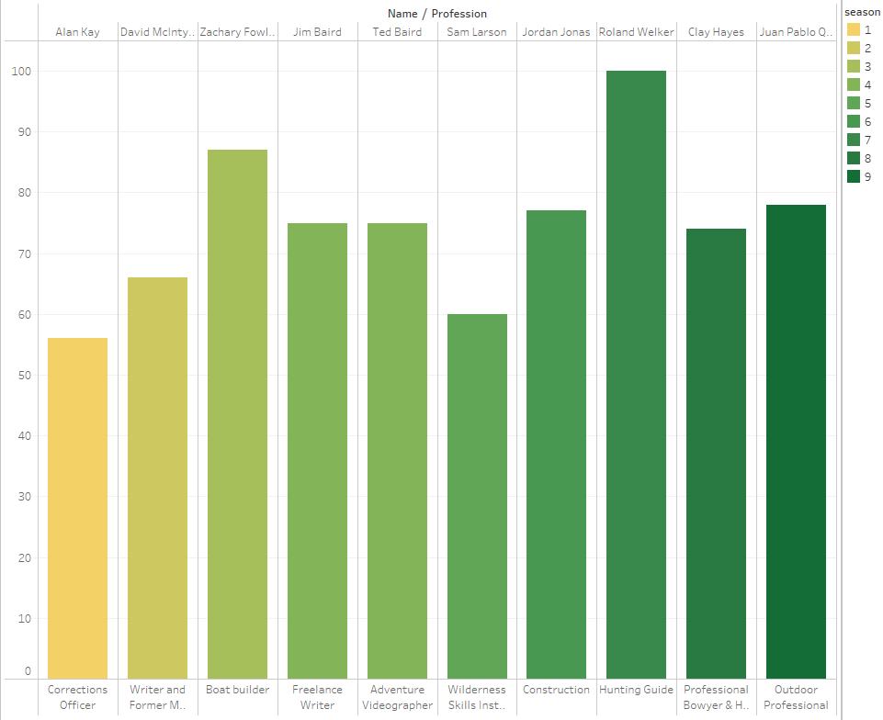
Season Winners

Slide 16
Conclusion

Slide 17
Thanks!
02/06/24
Do you have any questions?
www.linkedin.com/in/bryanortegaleon
https://github.com/baonline

